Slide 1
Sensitivity Analysis in R

Slide 2
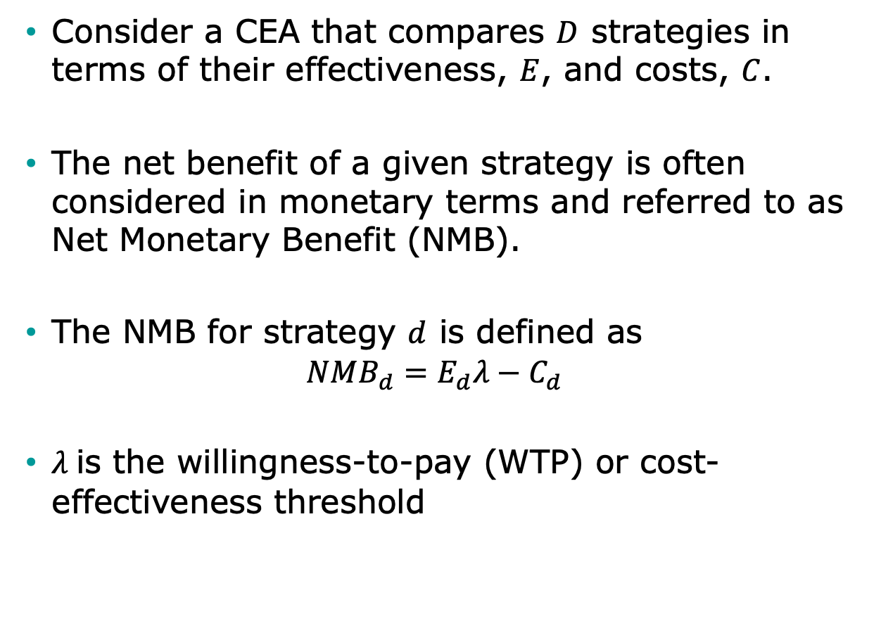
Brief note on CEA
Consider a CEA that compares $D$ strategies in terms of their effectiveness, $E$, and costs, $C$.
The net benefit of a given strategy is often considered in monetary terms and referred to as Net Monetary Benefit (NMB).
The NMB for strategy $d$ is defined as
$$NMB_{d}=E_{d}λ−C_{d}$$
$λ$ is the willingness-to-pay (WTP) or cost-effectiveness threshold

Slide 3
Sensitivity Analysis
Vary input parameters within plausible ranges
For which values is each strategy optimal?
Deterministic sensitivity analysis (DSA)
One-way analysis: vary one parameter, hold rest fixed
Two-way analysis: vary two parameters, hold rest fixed
Probabilistic sensitivity analysis (PSA)
Simultaneously vary input parameters by randomly sampling from appropriate probability distributions
How often is each alternative cost-effective?
What strategy has the highest expected net benefit

Slide 4
Parameter Uncertainty
Accounts for the likelihood of the values of each of the inputs and their effect on the model outputs
It is often conducted in a similar approach than PSA but distributions of inputs reflect current knowledge on the parameters

Slide 5
Deterministic Sensitivity Analysis

Slide 6
One-Way Sensitivity Analysis
Systematically vary a single parameter over range of uncertainty, keeping all others fixed
p_PCed = 30%, p_PCed = 40%, p_PCed = 50%, etc…
For each parameter value, calculate the expected outcomes under each strategy
Identify which strategy is preferred for each parameter value

Slide 7
One-Way Sensitivity Analysis
Probability of early detection (Primary care) | Deaths per 1,000
 | EV ‘Do Nothing’ | EV ‘Spray’ | EV ‘Test’
30% | 0.33 | 1.05 | 0.37
35% | 0.67 | 1.10 | 0.53
40% | 1.00 | 1.15 | 0.70
45% | 1.33 | 1.20 | 0.87
50% | 1.67 | 1.25 | 1.03
55% | 2.00 | 1.30 | 1.20
60% | 2.33 | 1.35 | 1.37
65% | 2.67 | 1.40 | 1.53

Slide 8
One-Way Sensitivity Analysis
Probability of early detection (Primary care) | Life Expectancy
 | Routine practice | Primary Care | Hospital Care
30% | 0.33 | 1.05 | 0.37
35% | 0.67 | 1.10 | 0.53
40% | 1.00 | 1.15 | 0.70
45% | 1.33 | 1.20 | 0.87
50% | 1.67 | 1.25 | 1.03
55% | 2.00 | 1.30 | 1.20
60% | 2.33 | 1.35 | 1.37
65% | 2.67 | 1.40 | 1.53

Slide 9
One-Way Sensitivity Analysis
Probability of early detection (Primary care) | Life Expectancy
 | Routine practice | Primary Care | Hospital Care
30% | 3.1 | 2.8 | 3.7
35% | 3.1 | 3.1 | 3.7
40% | 3.1 | 3.4 | 3.7
45% | 3.1 | 3.7 | 3.7
50% | 3.1 | 4.0 | 3.7
55% | 3.1 | 4.3 | 3.7
60% | 3.1 | 4.6 | 3.7
65% | 3.1 | 4.9 | 3.7

Slide 10
One-Way Sensitivity Analysis
Systematically vary a single parameter over range of uncertainty, keeping all others fixed
p.PCed = 30%, p.PCed = 40%, p.PCed = 50%, etc…
For each parameter value, calculate the expected outcomes under each strategy
Identify which strategy is preferred
‘Hospital Care’
‘Primary care’
30%
65%
Life Expectancy
= Base case

Slide 11
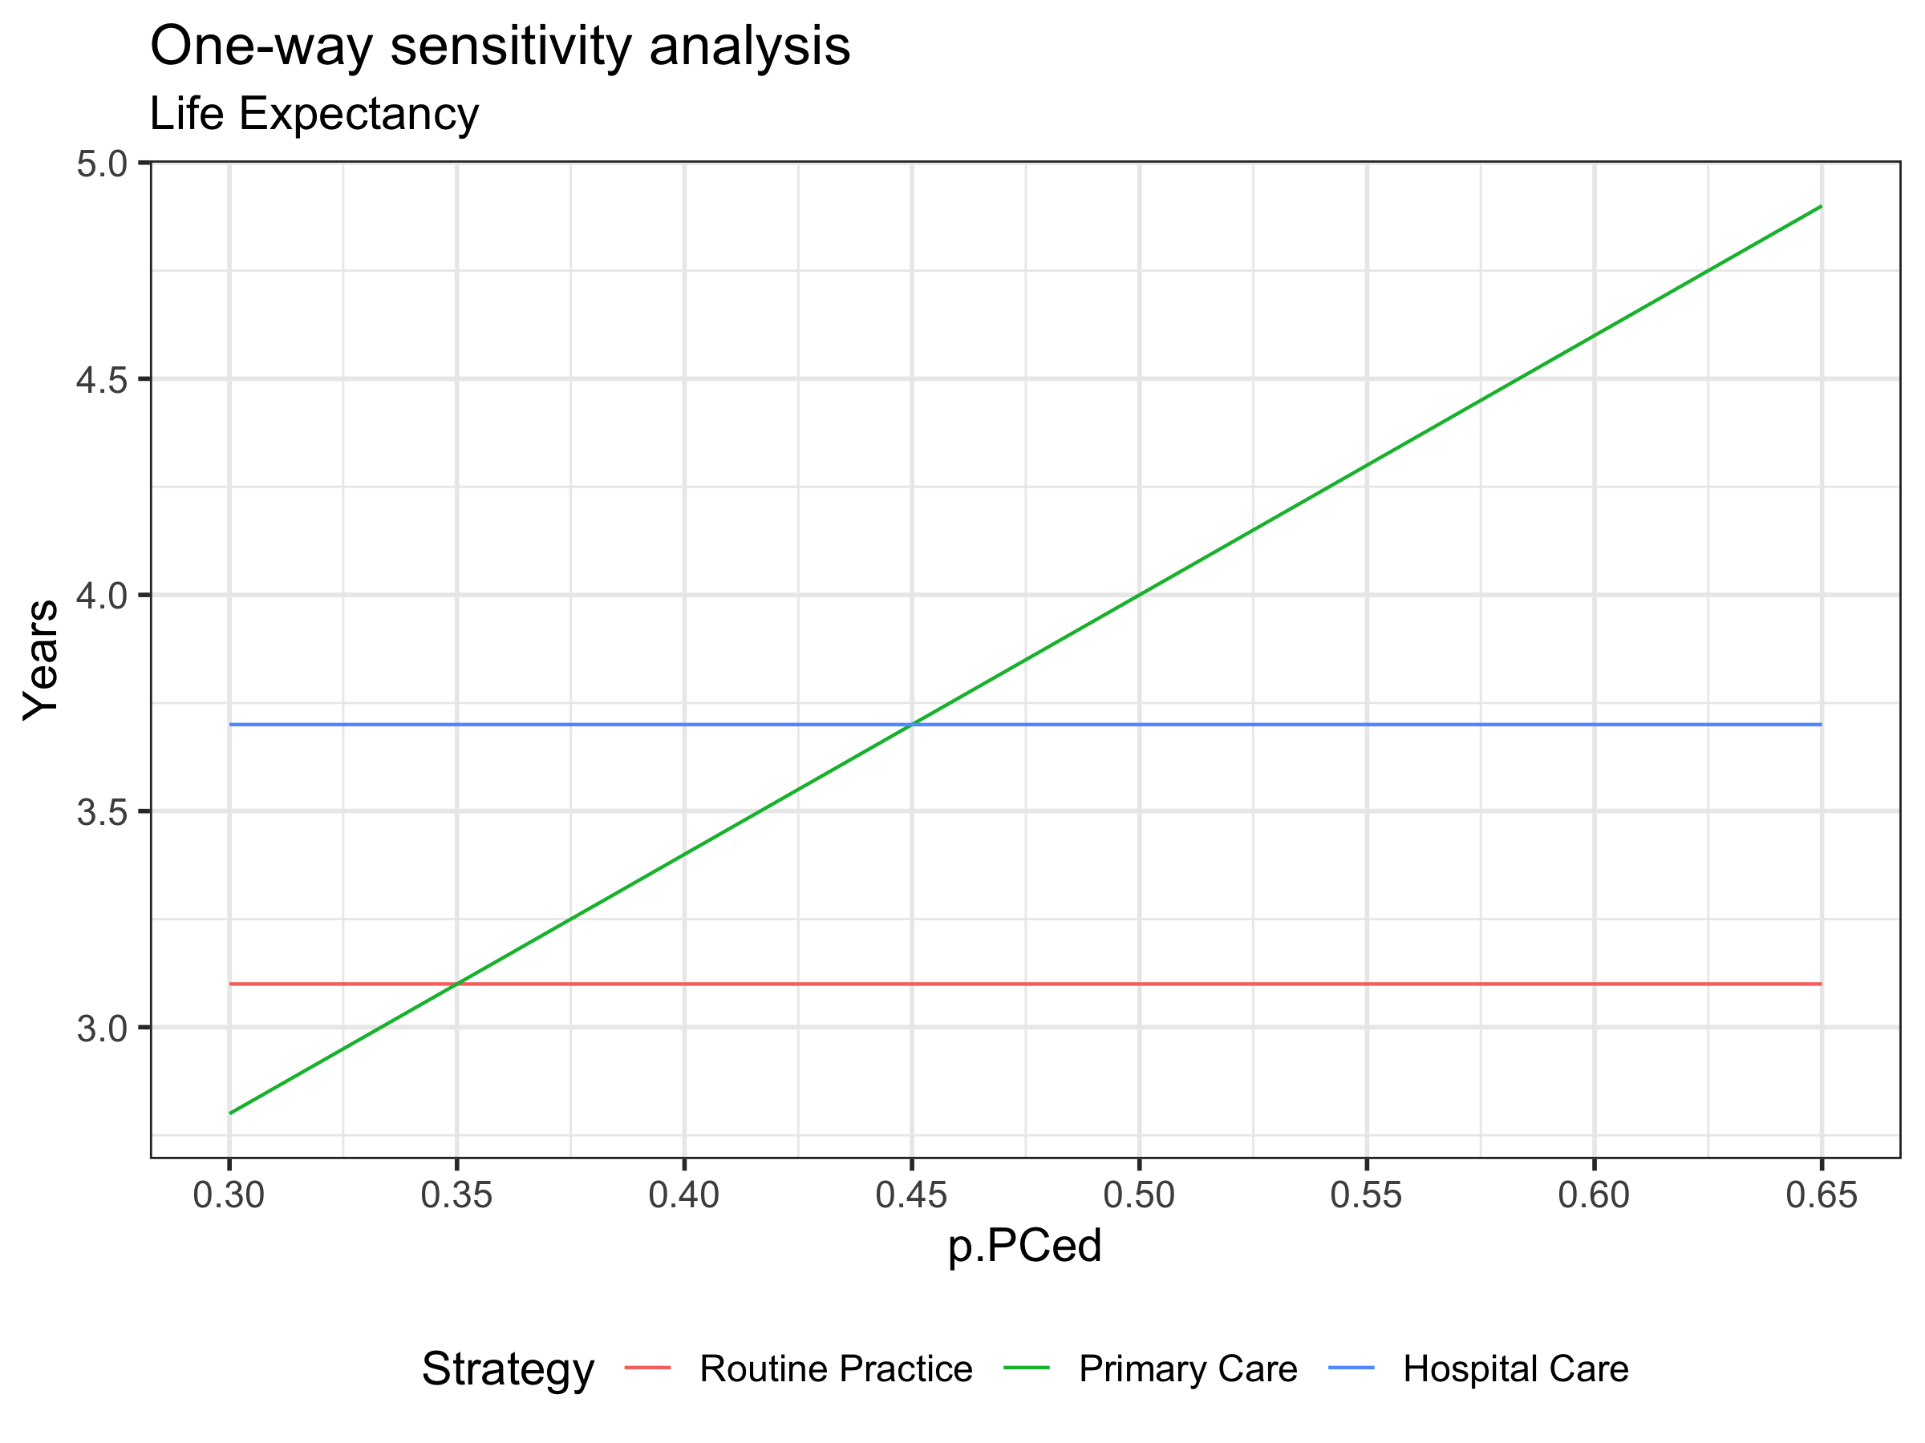
One-Way Sensitivity Analysis

Slide 12
Two-Way Sensitivity Analysis
Systematically vary two parameters over range of uncertainty, keeping all others fixed
p.PCed = 25%, p.HCed = 30%
p.PCed = 25%, p.HCed = 40%
p.PCed = 25%, p.HCed = 50%
p.PCed = 30%, p.HCed = 30%
p.PCed = 30%, p.HCed = 40%
etc…
Particularly useful if one parameter influences the impact of the other on the optimal decision

Slide 13
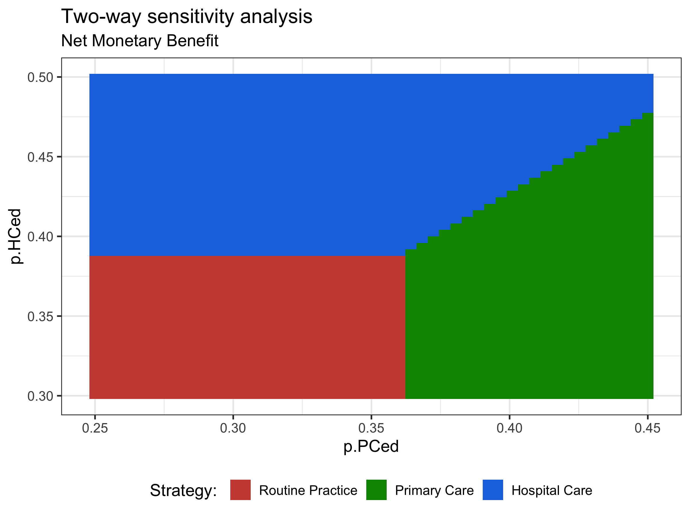
Two-Way Sensitivity Analysis

Slide 14
Probabilistic Sensitivity Analysis (PSA)

Slide 15
Probabilistic Sensitivity Analysis (PSA)
Inputs
Model
Outputs
x
1
Effect
x
NHB
2
Cost
x
i

Slide 16
Probabilistic Sensitivity Analysis (PSA)
p.HS
Healthy (H)
Sick (S)
p.HD
p.SD
Dead (D)

Slide 17
Probabilistic Sensitivity Analysis (PSA)
p.HS
Healthy (H)
Sick (S)
p.HD
p.SD
Dead (D)

Slide 18
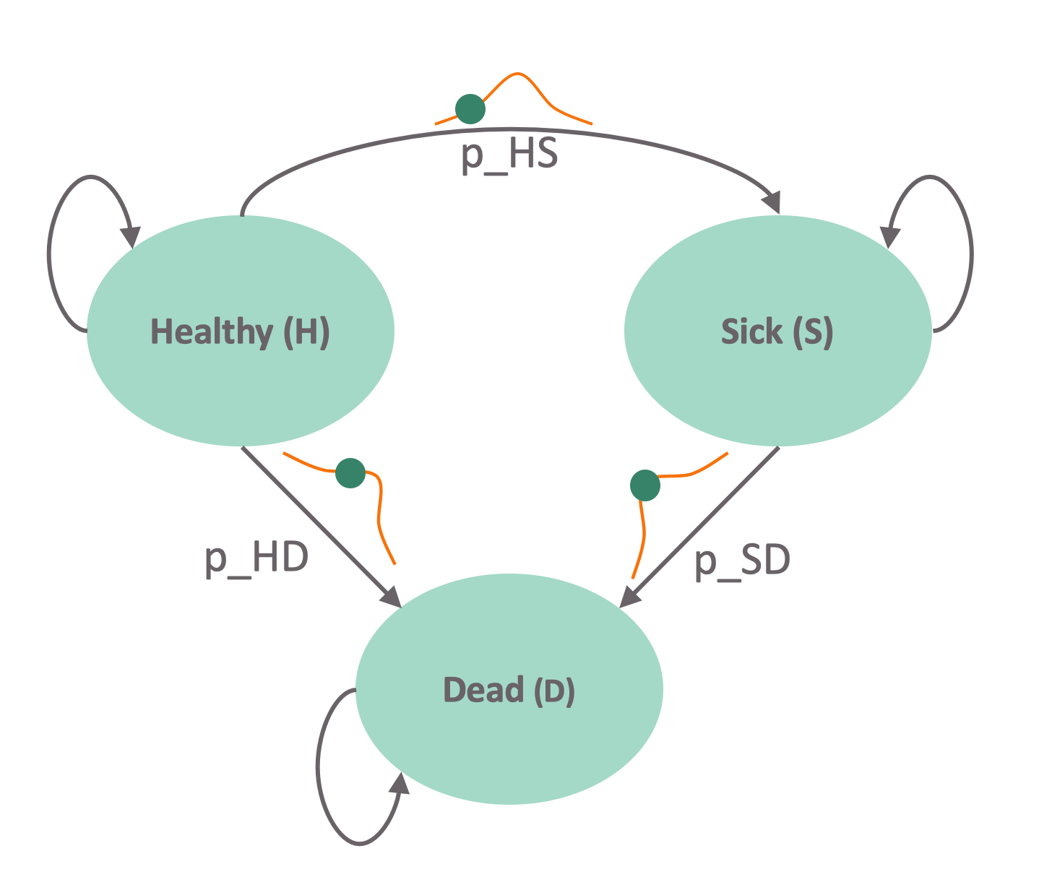
Matrix Implementation of the Markov Model
Transition probability matrix
Vector of cycle’s cost/outcomes
To:
 | Healthy | Sick | Dead
Healthy | 1 – p_HS – p_HD | p_HS | p_HD
Sick | 0 | 1 – p_SD | p_SD
Dead | 0 | 0 | 1
P¹ =
From:
c_{H}
c_{s}
0
e_{H}
e_{s}
0
c¹ =
e¹ =
Notes:
Who is familiar with basic matrix calculations?
-> Inner product

Slide 19
Markov trace
 | Healthy | Sick | Dead
Cycle 0 | 1 | 0 | 0
Cycle 1 | 0.98 | 0.01 | 0.01
… | 0.95 | 0.03 | 0.02
M¹ =
Time | Healthy | Sick | Dead | E[LYs]
0 | 1.0 | 0.0 | 0.0 | --
1 | 0.75 | 0.20 | 0.05 | 0.95
2 | 0.56 | 0.32 | 0.12 | 0.88
3 | 0.42 | 0.38 | 0.19 | 0.81
 | … | … | …

Slide 20

Calculating total costs & effects
E = M e
TE = ι_{T} E
Total effects (TE):
Total costs (TC):
Net Monetary Benefit (NMB):
1
1
1
1
C =M c
TC = ι_{T} C
1
1
1
1
$${NMB}^{1}=TE^{1}λ−TC^{1}$$
ι_{T} : 1 × T vector of ones
$λ$: Willingness-to-pay or cost-effectiveness threshold

Slide 21
Presenting the PSA results
TC
. (TE¹, TC¹)
0
TE

Slide 22
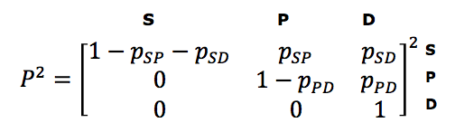
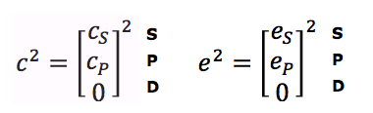
Matrix Implementation of the Markov Model
Transition probability matrix
Vector of cycle’s cost/outcomes
H S D
H
S
D
H
S
D
Notes:
Who is familiar with basic matrix calculations?
-> Inner product

Slide 23

Calculating total costs & effects
E =M e
TE = ι_{T} E
Total effects (TE):
Total costs (TC):
Net Monetary Benefit (NMB):
2
2
2
2
2
C =M c
TC = ι_{T} C
2
2
2
2
2
$${NMB}^{2}=TE^{2}λ−TC^{2}$$
ι_{T} : 1 × T vector of ones
$λ$: Willingness-to-pay or cost-effectiveness threshold

Slide 24
Presenting the PSA results
TC
. (TE², TC²)
. (TE¹, TC¹)
0
TE

Slide 25
Presenting the PSA results
TC
.
.
.
.
.
.
.
.
.
.
.
.
.
.
.
.
.
.
.
.
.
.
.
.
.
.
.
.
.
.
.
.
.
.
.
.
.
.
.
.
.
.
.
.
.
.
.
.
.
.
.
.
.
.
.
.
.
.
.
.
.
.
.
.
.
.
.
.
.
.
.
.
.
.
.
.
.
.
.
.
.
.
.
.
.
.
.
.
.
.
.
.
.
.
.
.
.
.
.
.
.
.
.
.
.
.
.
.
.
.
.
.
.
.
.
.
.
.
.
.
.
.
.
.
.
.
.
.
.
.
.
.
.
.
.
.
.
.
.
.
.
.
.
.
.
.
.
.
.
.
.
.
.
.
.
.
.
.
.
.
.
.
.
.
.
.
.
.
.
.
.
.
.
.
.
.
.
.
.
.
.
.
.
.
.
.
.
.
.
.
.
.
.
.
.
.
.
.
.
.
.
.
.
.
.
.
.
.
.
.
.
.
.
.
.
.
.
.
.
.
.
.
.
.
.
.
.
.
.
.
.
.
.
.
.
.
.
.
.
.
.
.
.
.
.
.
.
.
.
.
.
.
.
.
.
.
.
.
.
.
.
.
.
.
.
.
.
.
.
.
.
.
.
.
.
.
.
.
.
.
.
.
.
.
.
.
.
.
.
.
.
.
.
.
.
.
.
.
.
.
.
.
.
.
.
.
.
.
.
.
.
.
.
.
.
.
.
.
.
.
.
.
.
.
.
.
.
.
.
.
.
.
.
.
.
.
.
.
.
.
.
.
.
.
.
.
.
.
.
.
.
.
.
.
.
.
.
.
.
.
.
.
.
.
.
.
.
.
.
.
.
.
.
.
.
.
.
.
.
.
.
.
.
.
.
.
.
.
.
.
.
.
.
.
.
.
.
.
.
.
.
.
.
.
.
.
.
.
.
.
.
.
.
.
.
.
.
.
.
.
.
.
.
.
.
.
.
.
.
.
.
.
.
.
.
.
.
.
.
.
.
.
.
.
.
.
.
.
.
.
.
.
.
.
.
.
.
.
.
.
.
.
.
.
.
.
.
.
.
.
.
.
.
.
.
.
.
.
.
.
.
.
.
.
.
.
.
.
.
.
.
.
.
.
.
.
.
.
.
.
.
.
.
.
.
.
.
.
.
.
.
.
.
.
.
.
.
.
.
.
.
.
.
.
.
.
.
.
.
.
.
.
.
.
.
.
.
.
.
.
.
.
.
.
.
.
.
.
.
.
.
.
.
.
.
.
.
.
.
.
.
.
.
.
.
.
.
.
.
.
.
.
.
.
.
.
.
.
.
.
.
.
.
.
.
.
.
.
.
.
.
.
.
.
.
.
.
.
.
.
.
.
.
.
.
.
.
.
.
.
.
.
.
.
.
.
.
.
.
.
.
.
.
.
.
.
.
.
.
.
.
.
.
.
.
.
.
.
.
.
.
.
.
.
.
.
.
.
.
.
.
.
.
.
.
.
.
.
.
.
.
.
.
.
.
.
.
.
.
.
.
.
.
.
.
.
.
.
.
.
.
.
.
.
.
.
.
.
.
.
.
.
.
.
.
.
.
.
.
.
.
.
.
.
.
.
.
.
.
.
.
.
.
.
.
.
.
.
.
.
.
.
.
.
.
.
.
.
.
.
.
.
.
.
.
.
.
.
.
.
.
.
.
.
.
.
.
.
.
.
.
.
.
.
.
.
.
.
.
.
.
.
.
.
.
.
.
.
.
.
.
.
.
.
.
.
.
.
.
.
.
.
.
.
.
.
.
.
.
.
.
.
.
.
.
.
.
.
.
.
.
.
.
.
.
.
.
.
.
.
.
.
.
.
.
.
.
.
.
.
.
.
.
.
.
.
.
.
.
.
.
.
.
.
.
.
.
.
.
.
.
.
.
.
.
.
0
TE

Slide 26
Example of PSA dataset

Slide 27

Distributions
Distribution | Parameter modeled | Form | Comment
Uniform | Any | Range low-high | All values are equally likely. Uninformative distribution
Triangular | Any | Minimum, maximum, likeliest
Beta | Probability Quality of life weights (utility) | Beta (r,n): r = number of events and n = number of patients. For observed mean 𝜇 and standard error: | Bounded between 0 and 1
Dirichlet | Probability in the context of multiple events |  | Extension of the beta distribution, for multiple events
Hunink MGM, Weinstein MC, Wittenberg E, Drummond MF, Pliskin JS, Wong JB, Glasziou PP. Decision Making in Health and Medicine: Integrating Evidence and Values. Cambridge University Press, Cambridge, UK, 2014. ISBN 978-1-107-69047-9. Table 12.2, page 371
Notes:
Commonly used distribution to model parameter uncertainty

Slide 28

Distributions II
Distribution | Parameter modeled | Form | Comment
Lognormal | Rate Relative risk Hazard rate ratio Odds ratio Costs | ln(parameter) has a normal distribution with mean and standard error | Values >0, positively skewed
Gamma | Resource use Costs | Gamma (𝛼,𝛽) For observed mean 𝜇 and standard error s: | Values >0, positively skewed
Truncated |  |  | Restricting the domain of some other probability distribution
Histogram | Any | non-parametric | Based on trial data: observed relative frequency per value or per interval
Bootstrap | Any | non-parametric | Based on trial data: simulated relative frequency per value
Notes:
Hunink MGM, Weinstein MC, Wittenberg E, Drummond MF, Pliskin JS, Wong JB, Glasziou PP. Decision Making in Health and Medicine: Integrating Evidence and Values. Cambridge University Press, Cambridge, UK, 2014. ISBN 978-1-107-69047-9. Table 12.2, page 371

Slide 29
PSA in R
Common naming structure among (most) distributions in R
“q”+ dist. (e.g. qnorm()): quantile function
“d”+ dist.(e.g. dnorm()): density function
“p”+ dist.(e.g. pnorm()): c.d.f function
“r” + dist.(e.g. rnorm()): random number generating function
sample():Random number sampling with(out) replacement and weights (e.g. for bootstrapping)

Slide 30
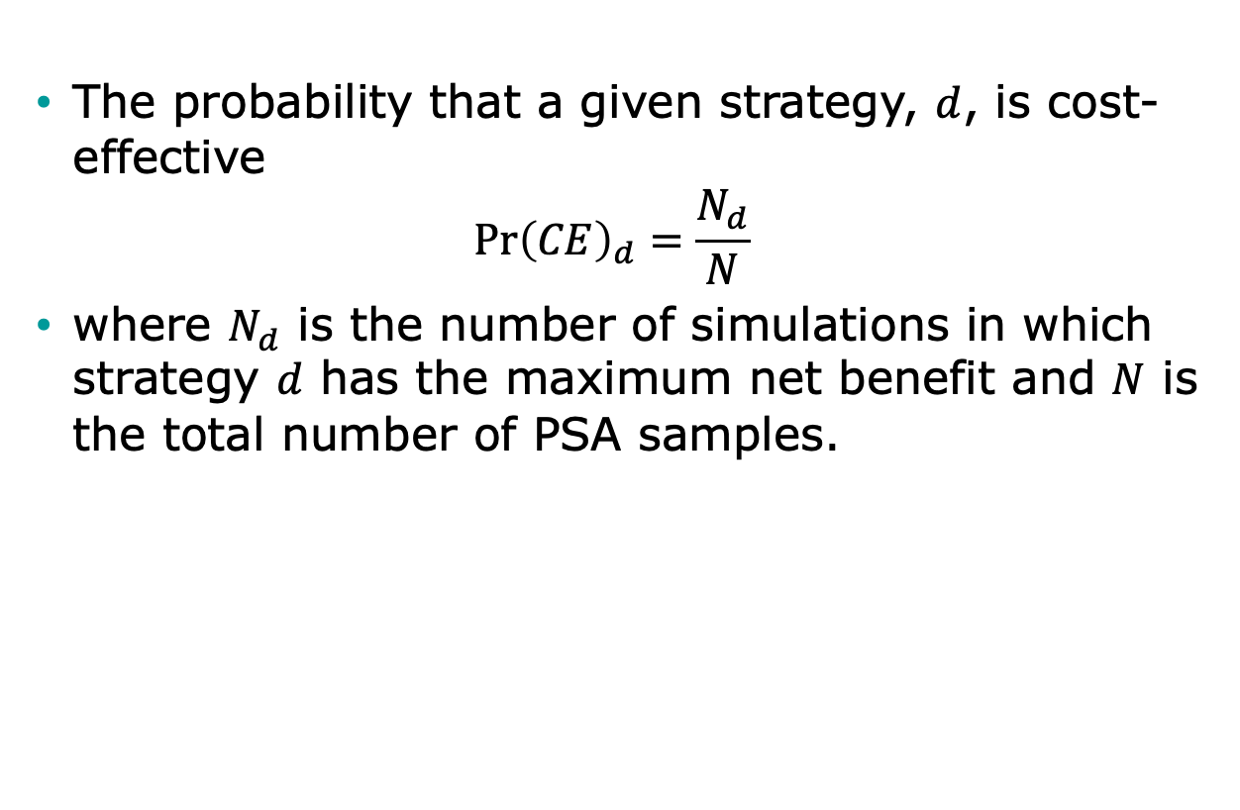
Decision Uncertainty
The probability that a given strategy, $d$, is cost-effective
$$\operatorname{Pr}{{\left(CE\right)}_{d}=\frac{N_{d}}{N}}$$
where $N_{d}$ is the number of simulations in which strategy $d$ has the maximum net benefit and $N$ is the total number of PSA samples.

Slide 31
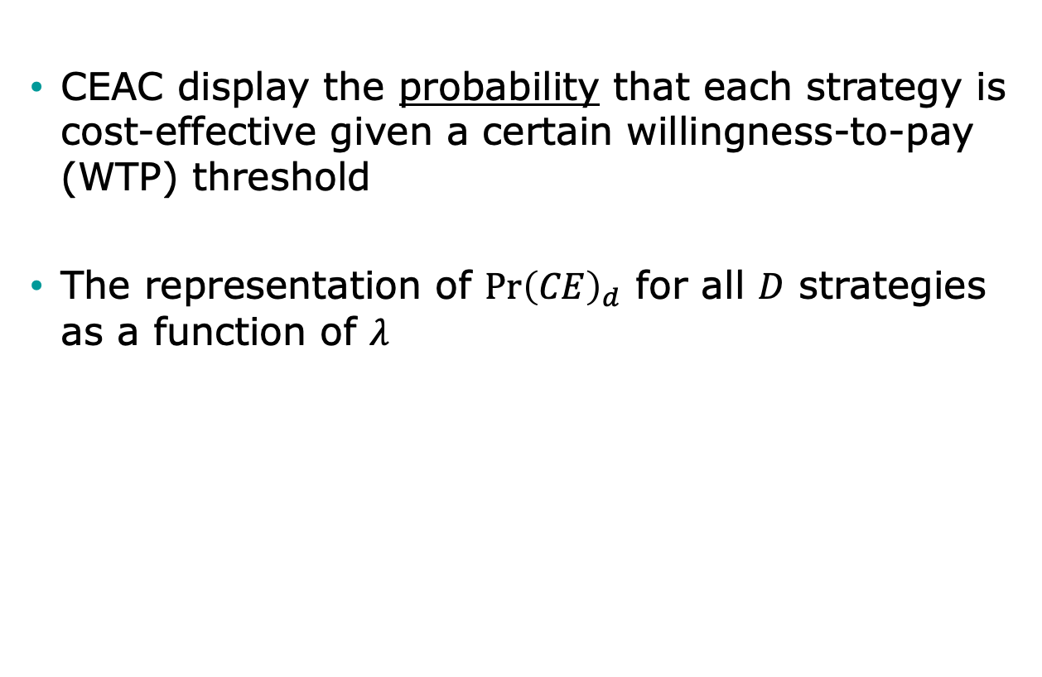
Cost-Effectiveness Acceptability Curves (CEAC)
CEAC display the probability that each strategy is cost-effective given a certain willingness-to-pay (WTP) threshold
The representation of $\operatorname{Pr}{{\left(CE\right)}_{d}}$ for all $D$ strategies as a function of $λ$

Slide 32


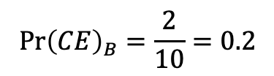
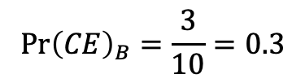

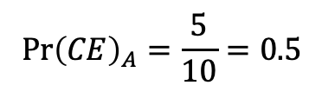

Construction of CEAC
$$N=10$$
$$N_{A}=5;$$
$$N_{B}=3;$$
$$N_{C}=2$$
$$\operatorname{Pr}{{\left(CE\right)}_{A}}=\frac{5}{10}=0.5$$
$$\operatorname{Pr}{{\left(CE\right)}_{B}}=\frac{3}{10}=0.3$$
$$\operatorname{Pr}{{\left(CE\right)}_{B}}=\frac{2}{10}=0.2$$
Highest probability

Slide 33
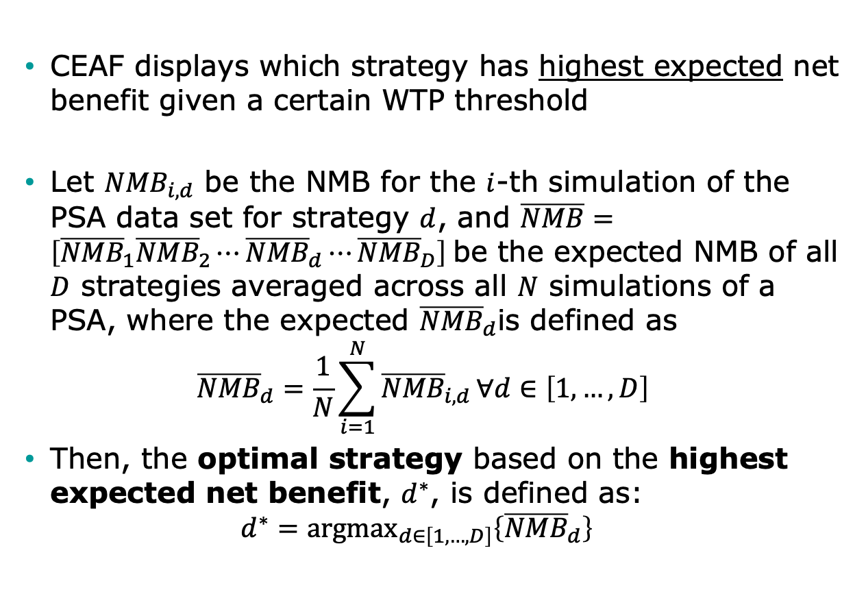
Cost-Effectiveness Acceptability Frontier (CEAF)
CEAF displays which strategy has highest expected net benefit given a certain WTP threshold
﻿Let ${NMB}_{i,d}$ be the NMB for the $i$-th simulation of the PSA data set for strategy $d$, and $\overline{NMB}=\left[{\overline{NMB}}_{1}{\overline{NMB}}_{2}⋯{\overline{NMB}}_{d}⋯{\overline{NMB}}_{D}\right]$be the expected NMB of all $D$ strategies averaged across all $N$ simulations of a PSA, where the expected ${\overline{NMB}}_{d}$is defined as
$${\overline{NMB}}_{d}=\frac{1}{N}\sum_{i=1}^{N}{{\overline{NMB}}_{i,d}}∀d∈\left[1,…,D\right]$$
Then, the optimal strategy based on the highest expected net benefit, $d^{∗}$, is defined as:
$$d^{∗}={\text{argmax}}_{d∈\left[1,…,D\right]}\left\{{\overline{NMB}}_{d}\right\}$$

Slide 34
Construction of CEAF
Highest expected net benefit = Optimal strategy

Slide 35
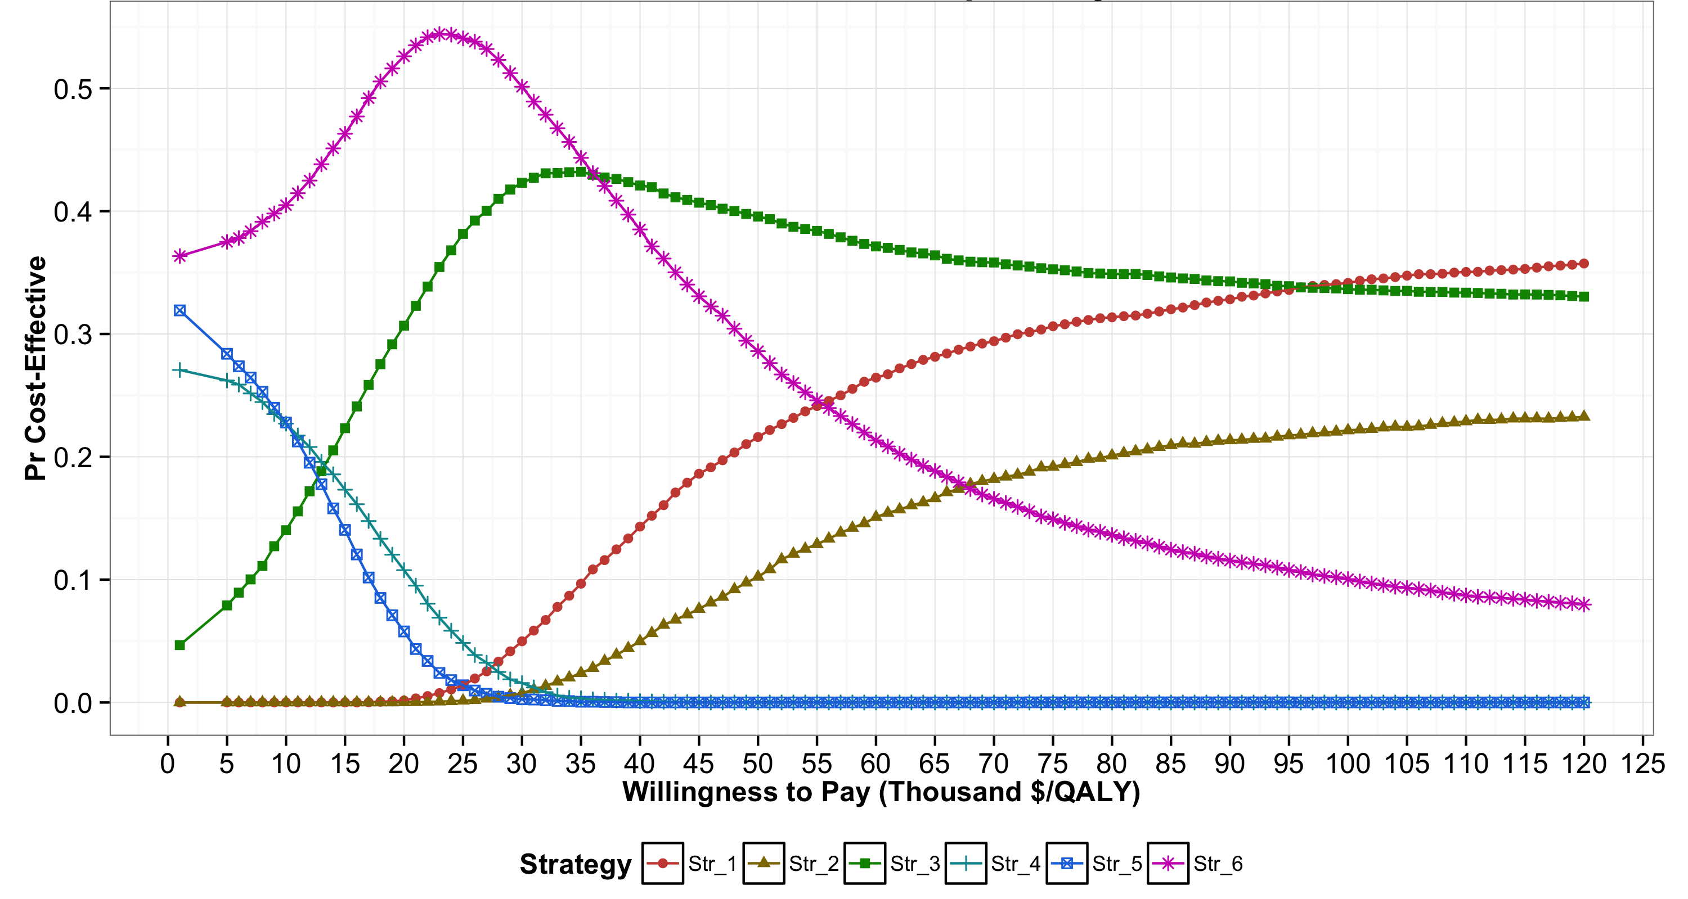
Cost-effectiveness acceptability curves (CEACs)

Slide 36
Cost-effectiveness acceptability curves (CEACs)

Slide 37
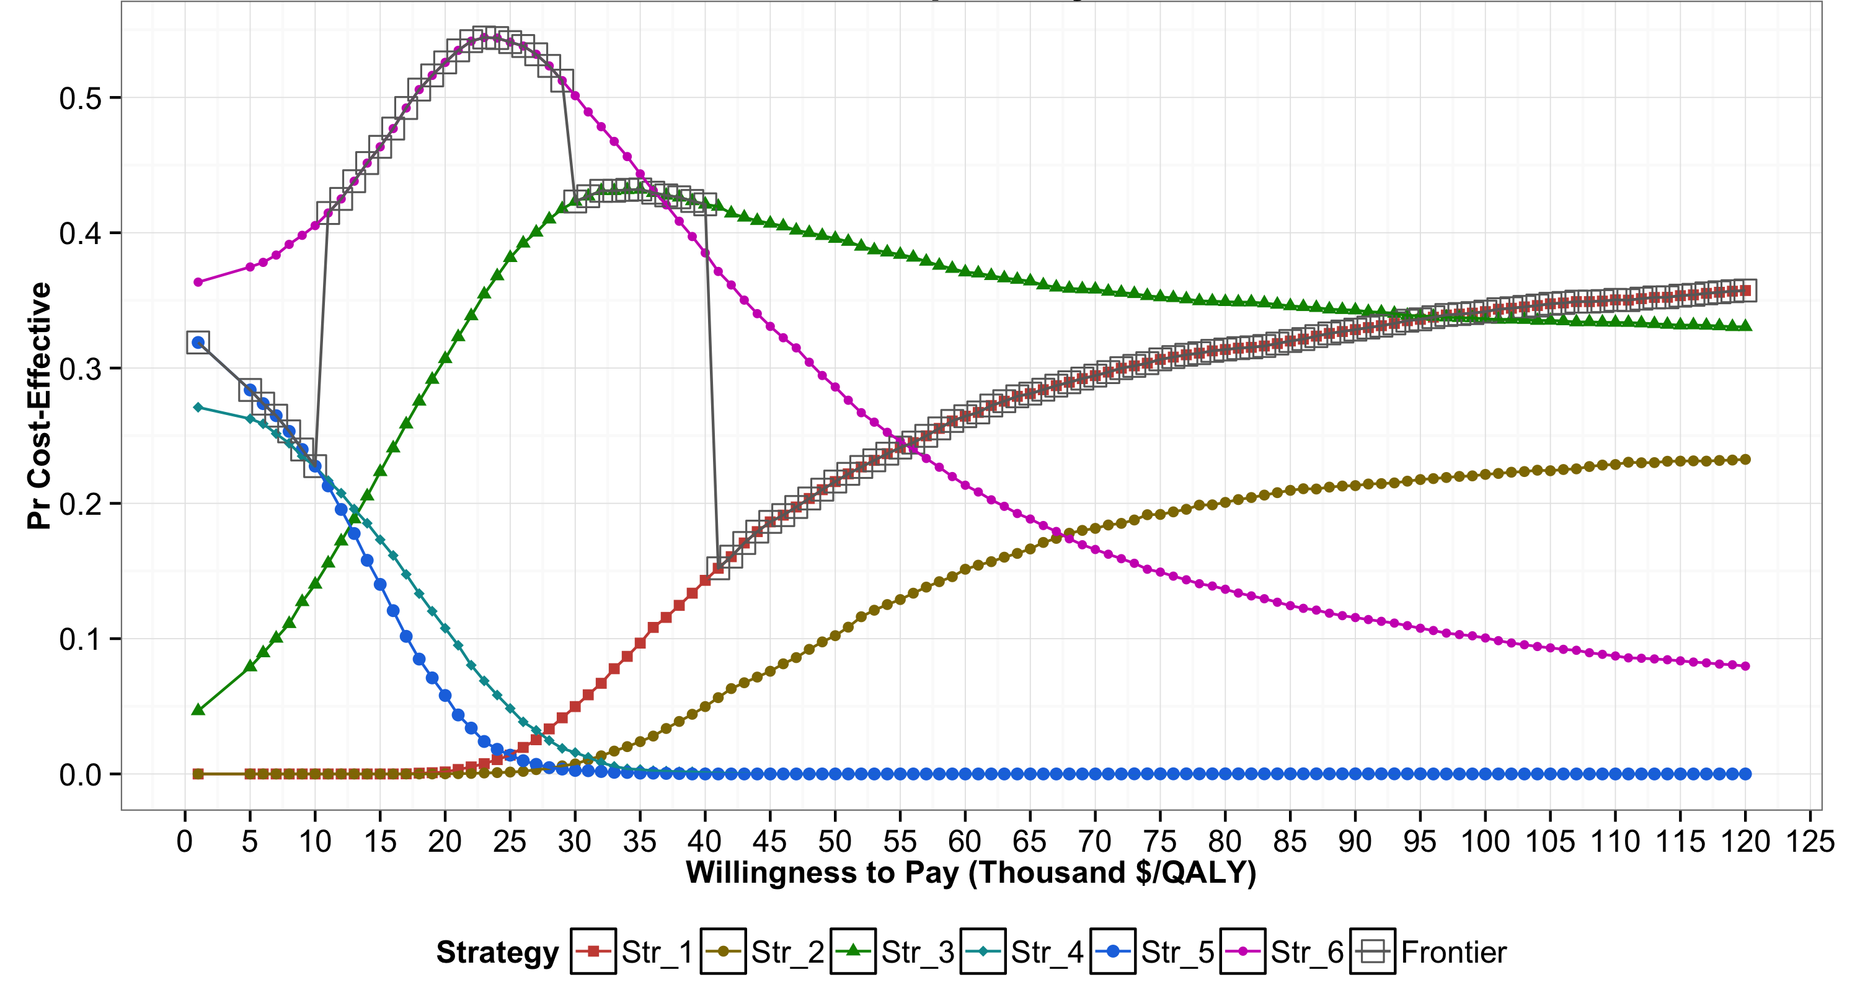
Cost-effectiveness acceptability curves (CEACs) and frontier (CEAF)

Slide 38
Cost-effectiveness acceptability curves (CEACs) and frontier (CEAF)

Slide 39
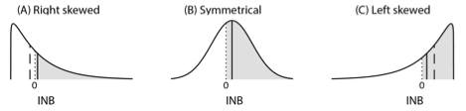
Distributions of Incremental NMB
Notes:
﻿The shaded area represents the probability of X being cost- effective compared to Y, which is the area under the curve to the right of INB = 0. The solid vertical line represents the expected INB of X vs. Y, and the dashed vertical line represents the median of the distribution of INB. X is optimal in all scenarios, but has the highest probability of being cost-effective only in scenarios B and C. In scenario B (i.e., symmetrical), the median and mean of INB coincide with each other.

Slide 40
Limitations of CEACs
Only provide certain level of comfort in a decision but do not influence decision making
Not actual influence on policy recommendation
Could be misleading -> ﻿the strategy that is most likely to be cost-effective should not be conflated with the strategy that is optimal in expectation in the decision-making process

Slide 41
Limitations of CEACs and CEAF
Neither ﻿capture the magnitude of the net benefit lost in the proportion of PSA samples when chosen strategy is not cost-effective
﻿The expected loss in net benefits is truly the concern of the decision-maker because this represents the foregone benefits resulting from having chosen a given strategy
﻿Do not communicate the ordinal information in the ranking of the strategies by their expected benefits
Useful when implementing the optimal strategy is not feasible.

Slide 42
Value of Information
How likely we are to make the wrong decision
And how bad it is to make the wrong decision
Cost of uncertainty (i.e., expected loss based on current information)
Expected benefit of potential future research
Can produce claims such as “How likely AND how bad?”

Slide 43
Expected Value of Perfect Information (EVPI)
Value of eliminating all sources of uncertainty for all parameters (𝜃)
Maximum willingness to pay to get perfect information on all parameters
No future data collection effort should exceed EVPI

Slide 44
Overcoming limitations of CEACs and CEAF
These limitations ﻿can be addressed by using expected loss curves (ELCs), previously proposed by others (Eckermann et al., 2008)
ELCs ﻿present a quantification of the consequences of choosing a suboptimal strategy in terms of expected foregone benefits as a function of WTP threshold
﻿ELCs also display the optimal strategy (like CEAF), the value of eliminating current level of decision uncertainty through additional research (like EVPI), and the ranking of strategies in terms of expected losses

Slide 45
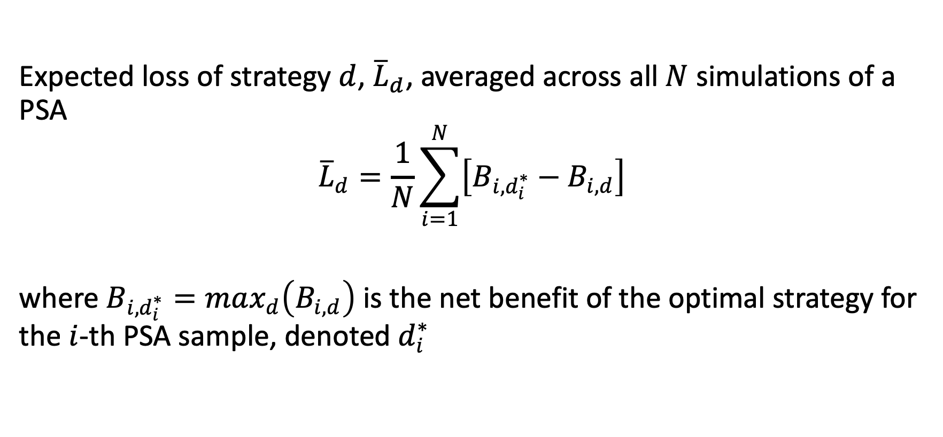
﻿Definition of expected losses
Expected loss of strategy $d$, ${\overline{L}}_{d}$, ﻿averaged across all $N$ simulations of a PSA
$${\overline{L}}_{d}=\frac{1}{N}\sum_{i=1}^{N}{\left[B_{i,d_{i}^{∗}}−B_{i,d}\right]}$$
where $B_{i,d_{i}^{∗}}=max_{d}\left(B_{i,d}\right)$ is the net benefit of the optimal strategy for the $i$-th PSA sample, denoted $d_{i}^{∗}$

Slide 46
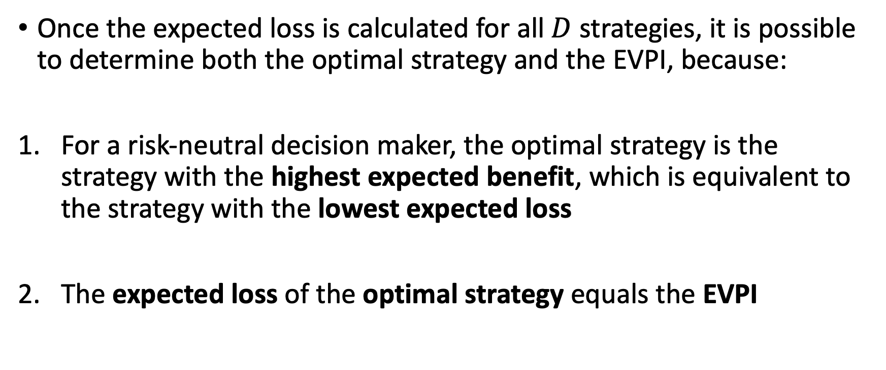
﻿Optimality criteria and VOI with expected losses
Once the expected loss is calculated for all $D$ strategies, it is possible to determine both the optimal strategy and the EVPI, because:
For a risk-neutral decision maker, the optimal strategy is the strategy with the highest expected benefit, which is equivalent to the strategy with the lowest expected loss
The expected loss of the optimal strategy equals the EVPI

Slide 47
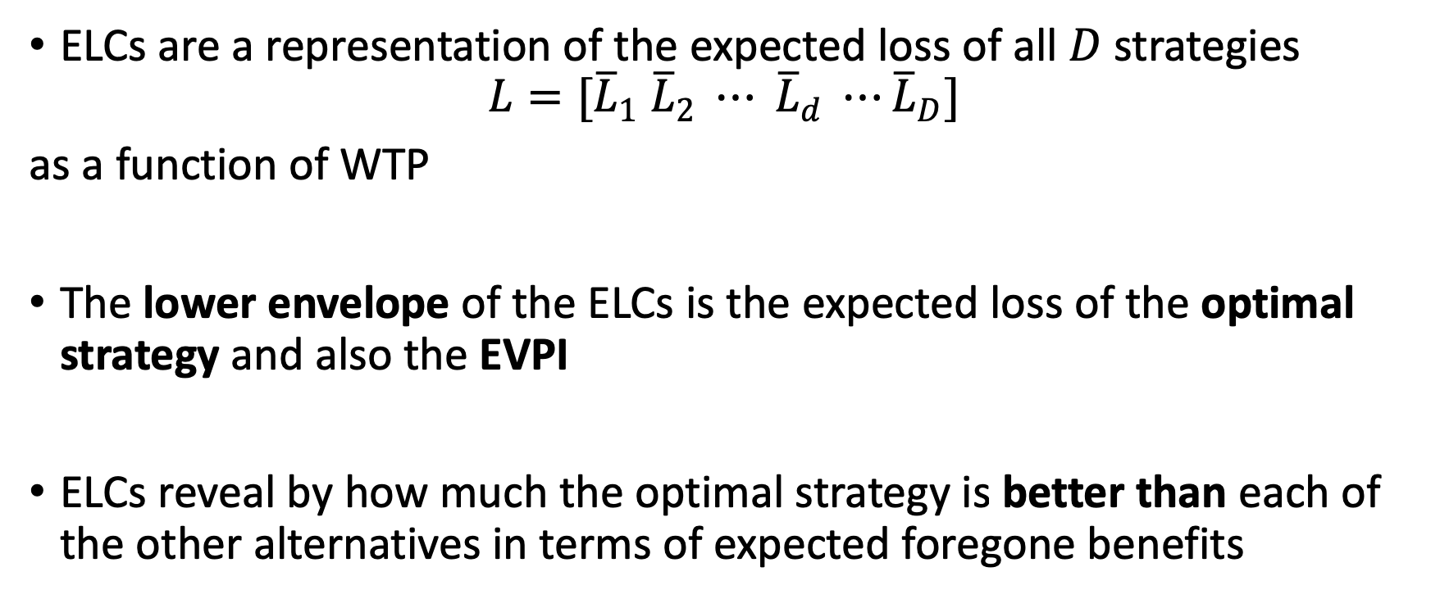
Expected Loss Curves (ELCs)
ELCs are a representation of the expected loss of all $D$ strategies
$$L=[{\overline{L}}_{1} {\overline{L}}_{2} ⋯ {\overline{L}}_{d} ⋯{\overline{L}}_{D}]$$
as a function of WTP
The lower envelope of the ELCs is the expected loss of the optimal strategy and also the EVPI
ELCs reveal by how much the optimal strategy is better than each of the other alternatives in terms of expected foregone benefits
Alarid-Escudero F, Enns EA, Kuntz KM, Michaud TL, Jalal H. “Time Traveling Is Just Too Dangerous” But Some Methods Are Worth Revisiting: The Advantages of Expected Loss Curves Over Cost-Effectiveness Acceptability Curves and Frontier. Value Health. 2019;In Press.

Slide 48
Construction of ELCs
Lowest expected loss = Optimal strategy

Slide 49
CEACs and CEAF

Slide 50
CEACs and CEAF

Slide 51
ELCs

Slide 52
ELCs

Slide 53
EVPI

Slide 54
R Session

